Slide 1
Random Graphs and Statistics Regarding Algebraic Connectivity
Rick Lage & Matthew Krause

Slide 2
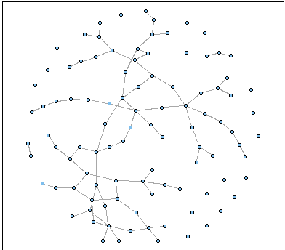
Introduction
We conducted research into the nature of random graphs to understand the quantitative potential to distinguish a random graph from an organized one

Slide 3
What is a Graph?
In graph theory a graph is a set of vertices (i.e. nodes or objects) connected to one another through connections called edges.
Real things represented as graphs:
Networks
Surfaces
Structures

Slide 4
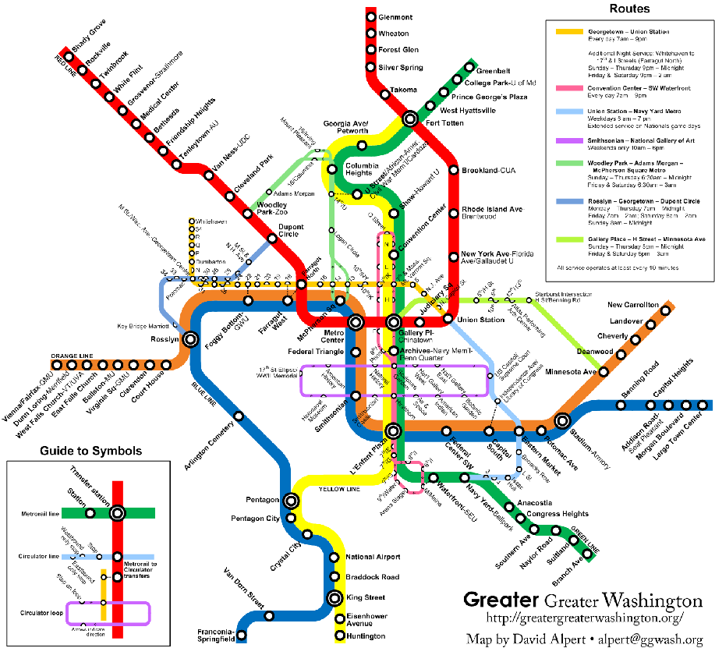

Slide 5
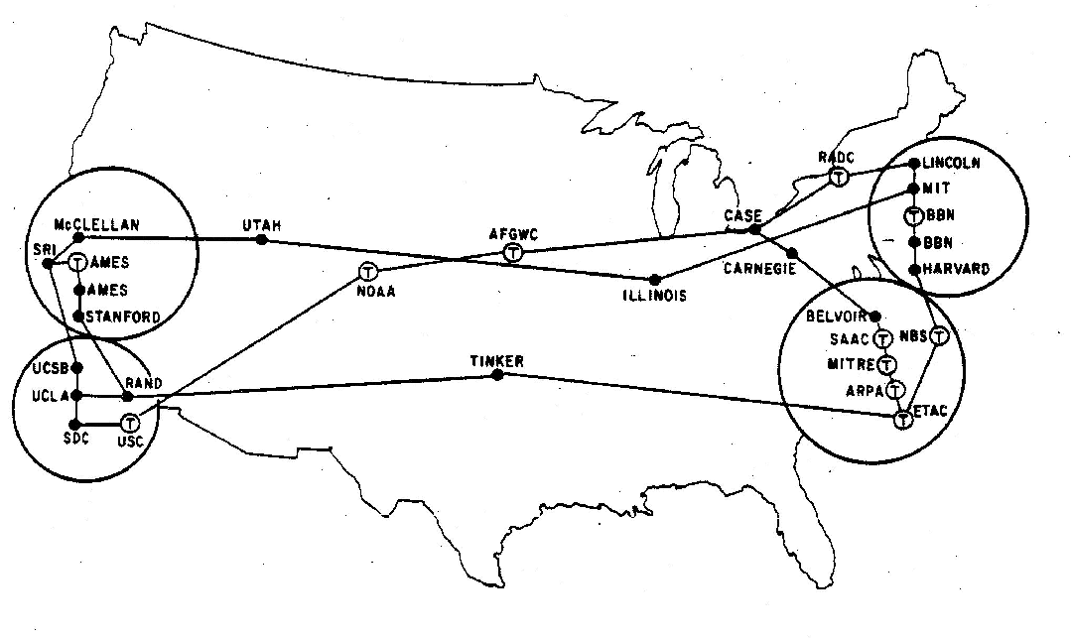
ARPANET

Slide 6
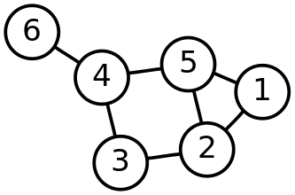
Representing Graphs

Slide 7
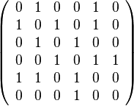
Adjacency Matrices

Slide 8
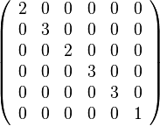
Degree Matrices

Slide 9
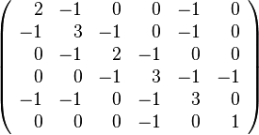
Laplacian Matrices

Slide 10
Eigenvalues
αv=λv
Where α is some n-by-n matrix
v is some non zero vector (the eigenvector)
λis some scalar (the eigenvalue)

Slide 11
Algebraic Connectivity
The second smallest eigenvalue of some n-by-n matrix
Usually the first non-zero eigenvalue
Is able to act as a descriptor of the connectivity of a graph
Connectivity is similar in some way to entropy

Slide 12
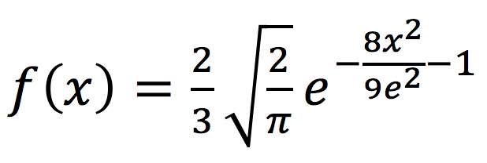
GEP(λ)
Using the properties of the statistics of Gilbert random graphs and their eigenvalues we assembled the Gilbert Eigenvalue Probability Function that will out put the probabilistic randomness of a given graph.

Slide 13
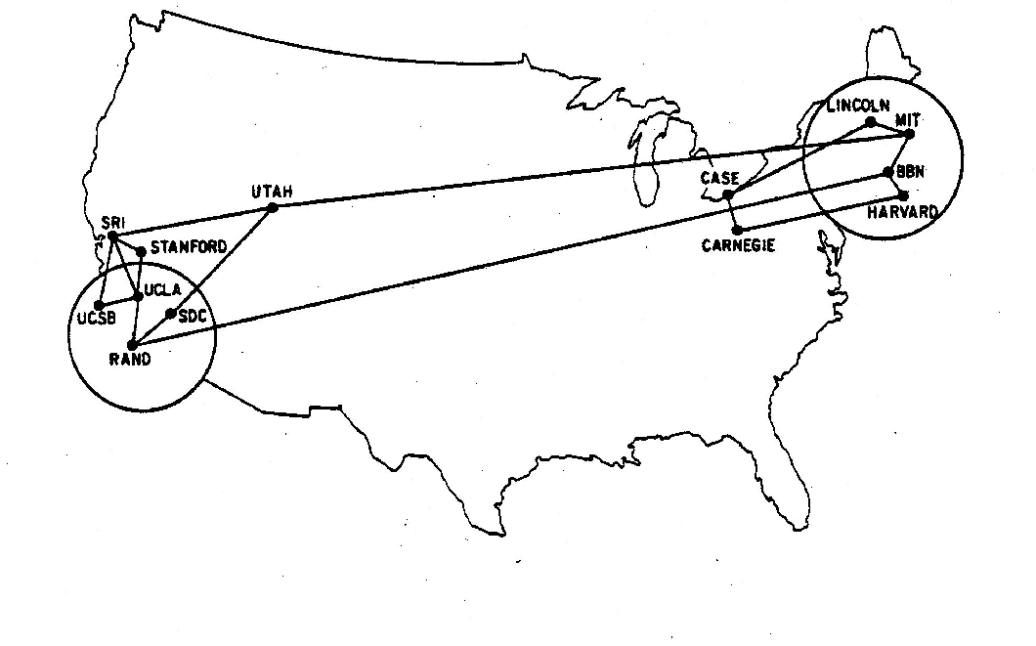
GEP(λ) Test Example:
ARPANET in June 1970

Slide 14
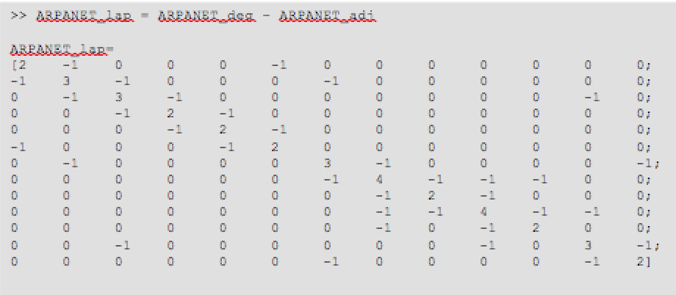
Laplacian Matrix of ARPANET

Slide 15
MATLAB Code
function [ snd ] = manmade( m )
%The function takes an input matrix and outputs the standard %normal distribution values of the lambda inputs. It also outputs %the mean of this distribution and the probability that it is %manmade.
%Determine the eigenvector of the input matrix, lambda
>> lambda = eig( m )
%define pi and e
>> e = 2.718281828;
>> p = 3.141592653589793238;
%determine the standard normal distribution of the lambda inputs %by using the GEP(lambda). The function is split into two parts %for computation efficiency.
>> snd_part1 = (1/((3*e)/(4))*(sqrt(2*p)));
>> snd_part2 = e.^((-(lambda.^2))/((4.*(e.^2))/(8)));
>> snd = snd_part1 * snd_part2;
%determine the average distribution among the standard normal %distribution
>> avg_dis = mean(snd)
%determine the probability that the graph is manmade
>> prob_man = (4.*e - avg_dis)/(4.*e)
end

Slide 16
MATLAB Output
>> manmade( ARPANET_lap )
avg_dis =
0.4465
prob_man =
0.9589
snd =
1.2295
1.2048
0.9788
0.9076
0.5785
0.4164
0.3209
0.0965
0.0479
0.0188
0.0032
0.0010
0.0003

Slide 17
Random Laplacian Matrix
function [ rand_lap ] = randZeros( n )
%Computers a random Laplacian Matrix and displays the %corresponding adjacency matrix and degree matrix.
%Creates the random adjacency matrix, M.
>> M = round(rand(n));
for i = 1:n
>> M(i,i) = 0;
end
for i = 1:n
for j = 1:n
>> M(i,j) = M(j,i);
end
end
%Assigns adjacency matrix M to the variable rand_adj and displays %it as an output.
>> rand_adj = M
%Creates the values that will be in the random degree matrix and %the inserts them into the random degree matrix.
>> deg_val = sum(M);
>> rand_deg = zeros(n);
for i = 1:n
>> rand_deg(i,i) = deg_val(i);
end
%Displays random degree matrix.
>> rand_deg = rand_deg
%Computes the random Laplacian Matrix and outputs it as 'ans'.
>> rand_lap = rand_deg - rand_adj;
end

Slide 18
Additional Images Cited
http://cneurocvs.rmki.kfki.hu/igraphbook/random.png
http://borderstan.files.wordpress.com/2009/04/circmetrolarge.pn
http://som.csudh.edu/fac/lpress/history/arpamaps/f10aug1972.jpg

